Slide 1


Connor Logue
June , 2025

Slide 2
Outline
Executive Summary
Introduction
Methodology
Results
Conclusion
Appendix

Slide 3
Executive Summary
Research Objective
The objective of this research is to analyze SpaceX Falcon 9 launch data gathered from multiple sources and apply Machine Learning techniques to predict the success of first-stage landings. These predictions can assist other space agencies in deciding whether to compete with SpaceX for launch contracts.
Summary of Methodologies
The following methods and techniques were used to collect, process, analyze the data, and develop predictive models:
Data collection through APIs and web scraping
Data transformation using data wrangling techniques
Exploratory data analysis (EDA) using SQL and visualizations
Creation of an interactive map with Folium to assess proximity to launch sites
Development of an interactive dashboard with Plotly Dash to explore launch records
Implementation of a Machine Learning model to predict the success of Falcon 9’s first-stage landings
Summary of Results
The findings will be presented in the following formats:
Insights from data analysis
Visualizations and interactive dashboards
Results from predictive model evaluations

Slide 4
Introduction
Project Background and Context
The rise of private space travel has made the space industry more mainstream and accessible.
Despite this progress, high launch costs remain a major barrier for new entrants.
SpaceX gains a competitive edge through its reusable first-stage technology.
A typical SpaceX launch costs about $62 million, significantly lower than competitors who may spend over $165 million per launch.
This cost advantage makes SpaceX a strong contender in the commercial launch market.
Key Research Questions
Can we predict if the first stage of Falcon 9 will land successfully?
What factors influence landing success (e.g., launch site, payload mass, booster version)?
Are there correlations between launch sites and first-stage landing success rates?

Slide 5

5

Slide 6
Methodology
Collected launch data via SpaceX API and web scraping Falcon 9/Falcon Heavy records from Wikipedia
Performed data wrangling to clean and structure the dataset for analysis
Created training labels by converting mission outcomes into binary classes (0 = unsuccessful, 1 = successful)
Conducted exploratory data analysis (EDA) using SQL queries and data visualizations
Built interactive visual tools using Folium (for launch site mapping) and Plotly Dash (for dashboard analytics)
Performed predictive analysis using supervised classification models
Engineered a 'class' column, standardized data, and split into training/test sets
Evaluated multiple classifiers: Logistic Regression, SVM, Decision Tree, and K-Nearest Neighbors (KNN) to determine the best model
6

Slide 7
Data Collection
Data collection involves gathering information from various sources, which may be structured, unstructured, or semi-structured. In this project, data was obtained from the SpaceX API, providing structured launch data, and through web scraping relevant Wikipedia pages to extract additional details about Falcon 9 and Falcon Heavy launches.
SpaceX API Web scraping data from Wiki
Read API response
Read .json response and convert to a Dataframe
Convert to CSV format
Convert new Dataframe to CSV format for the next phase
Create Beautiful Soap
Create beautiful soap object from HTML response
Convert to CSV format
Convert Dataframe to CSV for next phase
Request launch data from SpaceX API
Extract relevant data fields to match the requirements
Prelim data wrangling
Request Falcon9 html page via HTTP GET method
Collect all relevant headers/extract rows to Datafame
API request
Perform HTTP GET
Extract data to DF
7

Slide 8
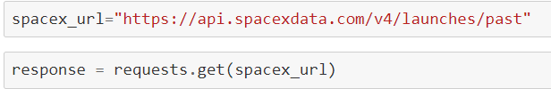
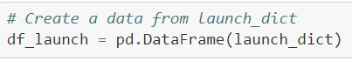
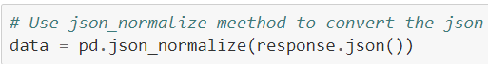
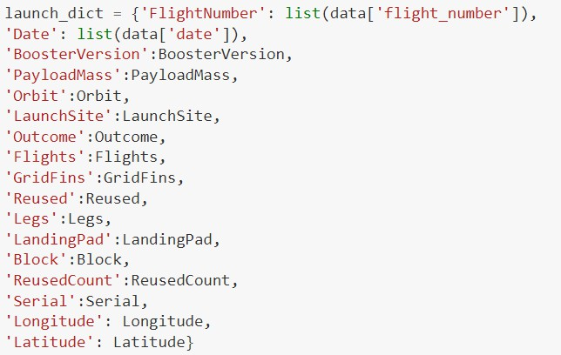
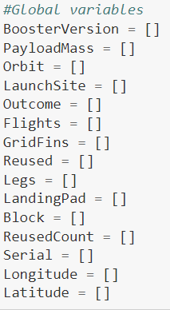
Data Collection – SpaceX API
1. API Request and read response into DF
2. Declare global variables
3. Call helper functions with API calls to populate global vars
4. Construct data using dictionary
5. Convert Dict to Dataframe, filter for Falcon9 launches, covert to CSV
1. Create API GET request, normalize data and read in to a Dataframe:
Call helper functions to get relevant data where columns have IDs (e.g., rocket column is an identification number)
getBoosterVersion(data)
getLaunchSite(data)
getPayloadData(data)
getCoreData(data)
4. Create Dataframe from dictionary and filter to keep only the Falcon9 launches:
• c
4. Construct dataset from received data & combine columns into a dictionary:
2. Declare global variable lists that will store data returned by helper functions with additional API calls to get relevant data
DataScienceCapstoneProjectRepository/Data Collection API Lab.ipynb at main · conorlogue1998dev/DataScienceCapstoneProjectRepository

Slide 9
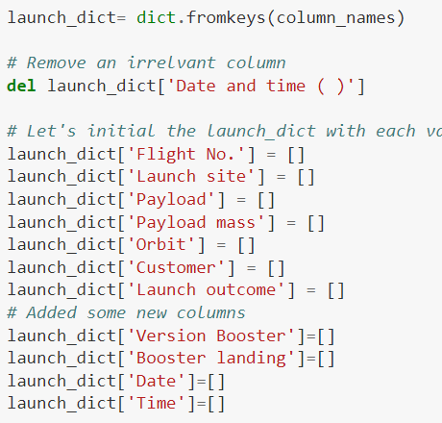
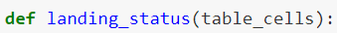
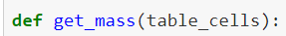
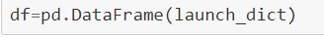
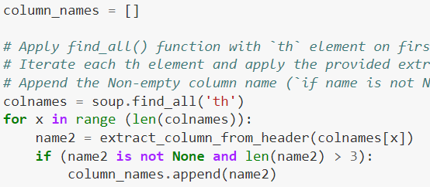
Data Collection - Scraping
1. Perform HTTP GET to request HTML page
2. Create Beautiful Soap object
3. Extract column names from HTML table header
4. Create Dictionary with keys from extracted column
names
5. Call helper functions to fill up dict with launch records
6. Convert Dictionary to Dataframe
1. Create API GET method to request Falcon9 launch HTML page
4. Create an empty Dictionary with keys from extracted column names:
Fill up the launch_dict with launch records extracted from table rows.
Utilize following helper functions to help parse HTML data
• c
2. Create Beautiful Soap object
3. Find all the tables on the Wiki page and extract relevant column names from the HTML table header
6. Convert launch_dict to Dataframe:
DataScienceCapstoneProjectRepository/Falcon9_Data_Collection_with_Web_Scraping.ipynb at main · conorlogue1998dev/DataScienceCapstoneProjectRepository

Slide 10
Data Wrangling
Exploratory Data Analysis (EDA)
Exploratory Data Analysis was performed to uncover patterns in the dataset and to define labels for training supervised machine learning models. The dataset included a variety of mission outcomes, which were converted into binary training labels:
1 = Successful booster landing
0 = Unsuccessful booster landing
The following landing scenarios were used to determine the labels:
True Ocean – Successful landing in a designated ocean region
False Ocean – Unsuccessful landing attempt in the ocean
RTLS – Successful landing at a ground-based Return to Launch Site pad
False RTLS – Unsuccessful landing attempt at RTLS
True ASDS – Successful landing on an Autonomous Spaceport Drone Ship
False ASDS – Unsuccessful landing attempt on a drone ship
DataScienceCapstoneProjectRepository/SpaceX_Falcon9_DataWrangling.ipynb at main · conorlogue1998dev/DataScienceCapstoneProjectRepository

Slide 11
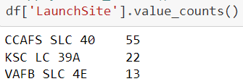
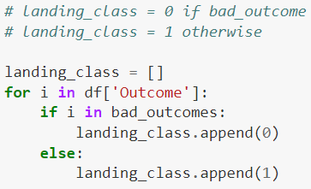
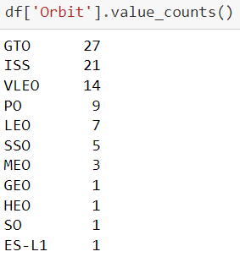
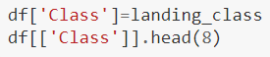
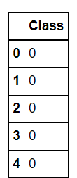
Data Wrangling – cont’d
1. Load dataset in to Dataframe
2. Find patterns in data
3. Create landing outcome label
1. Load SpaceX dataset (csv) in to a Dataframe
Find data patterns:
Calculate the number of launches on each site
Calculate the number and occurrence of each orbit
Calculate number/occurrence of mission outcomes per orbit type
3. Create a landing outcome label from Outcome column in the Dataframe
11

Slide 12
EDA with Data Visualization
As part of the EDA process, several charts were created to explore relationships within the dataset and uncover meaningful patterns.
Scatter Plots Used to identify correlations between two variables and highlight observable patterns. The following scatter plots were generated:
Flight Number vs. Launch Site
Payload Mass vs. Launch Site
Flight Number vs. Orbit Type
Payload Mass vs. Orbit Type
Bar Chart Helpful for comparing values across categories. The length of each bar represents the magnitude of the value, making it easy to identify dominant or frequent groups.
Plotted to visualize the success rate by orbit type
Line Chart Commonly used to track changes over time and visualize trends.
Plotted to observe the average launch success trend by year
DataScienceCapstoneProjectRepository/SpaceX_Falcon9_EDA_VizLab.ipynb at main · conorlogue1998dev/DataScienceCapstoneProjectRepository
12

Slide 13
EDA with SQL
To gain deeper insights into the SpaceX dataset, the following SQL queries were executed on an IBM DB2 cloud instance:
Retrieve the names of all unique launch sites involved in the missions
Display 5 records where launch site names start with the string ‘CCA’
Calculate the total payload mass carried by boosters launched by NASA’s Commercial Resupply Services (CRS)
Find the average payload mass for booster version F9 v1.1
Identify the date of the first successful landing at a ground pad
List boosters that had successful drone ship landings with payload masses between 4000 and 6000
Count the total number of successful and failed mission outcomes
List booster versions that carried the maximum payload mass using a subquery
Retrieve failed drone ship landings in 2015, including booster versions and launch site names
Rank the count of different landing outcomes (e.g., Failure on drone ship, Success on ground pad)
DataScienceCapstoneProjectRepository/SpaceX_Falcon9_EDA_SQL.ipynb at main · conorlogue1998dev/DataScienceCapstoneProjectRepository

Slide 14
Build an Interactive Map with Folium
Folium was used to create an interactive map for analyzing geospatial data and better understanding how location and proximity factors impact launch success rates.
Key features added to the map:
Marked all launch sites for visual reference
Added folium.Circle and folium.Marker to highlight launch sites with labeled circles
Implemented MarkerCluster() to show success (green) and failure (red) markers for each launch site
Calculated distances between launch sites and nearby features such as coastlines, railroads, highways, and cities
Added MousePosition() to display mouse cursor coordinates on the map
Used folium.Marker() to display distance values (in KM) at proximity points
Drew lines with folium.Polyline() between launch sites and proximity points (coastline, railroad, highway, city)
Repeated above steps for all proximity types to visualize spatial relationships
Insights from the Interactive Map
Launch sites are close to the coastline — Yes
Launch sites maintain a certain distance from cities — Yes
DataScienceCapstoneProjectRepository/SpaceX_Falcon9_Interactive_Viz_Folium.ipynb at main · conorlogue1998dev/DataScienceCapstoneProjectRepository

Slide 15
Build a Dashboard with Plotly Dash
Interactive Dashboard with Plotly Dash
A Plotly Dash web application was developed to enable real-time interactive visual analytics on SpaceX launch data. The dashboard includes the following components:
Launch Site Drop-down: Allows filtering by all launch sites or a specific launch site
Pie Chart: Displays total successful launches when “All Sites” is selected, and success vs. failure counts when a particular site is chosen
Payload Range Slider: Enables selection of different payload mass ranges to explore patterns visually
Scatter Chart: Shows correlation between payload mass and mission outcomes, with points color-coded by booster version
Dashboard Insights
Site with the largest number of successful launches: KSC LC-39A (10 launches)
Site with the highest launch success rate: KSC LC-39A (76.9%)
Payload range with highest success rate: 2000–5000 kg
DataScienceCapstoneProjectRepository/SpaceX_Falcon9_Plotly_Dashboard.py at main · conorlogue1998dev/DataScienceCapstoneProjectRepository

Slide 16
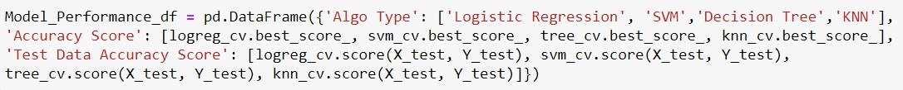
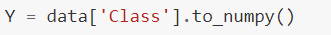
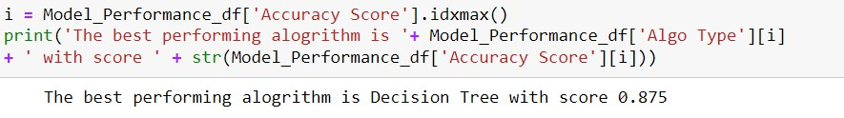
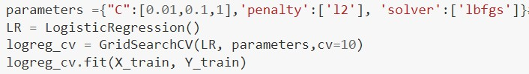
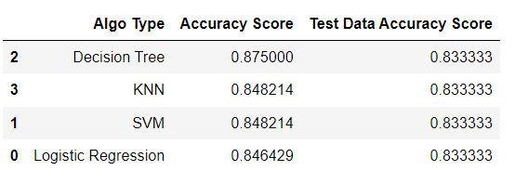
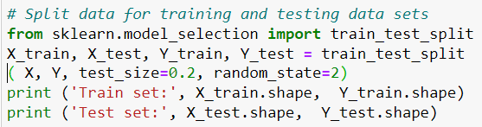
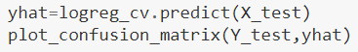
Predictive Analysis (Classification)
1. Read dataset into Dataframe
and create a ‘Class’ array
2. Standardize the data
3. Train/Test/Split data in to
training and test data sets
4. Create and Refine Models
5. Find the best performing
Model
1. Load SpaceX dataset (csv) in to a Dataframe and create NumPy array from the column class in data
Create and refine Models based on following classification Algorithms: (below is LR example)
Create Logistic Regression object and then
create a GridSearchCV object
Fit train data set in to the GridSearchCV object and train the Model
Find and display best hyperparameters and accuracy score
Check the accuracy on the test data by creating a confusion matrix
Repeat above steps for Decision Tree, KNN, and SVM algorithms
3. Find the best performing model
2. Standardize data in X then reassign to variable X using transform
3. Train/test/split X and Y in to training and test data sets.
DataScienceCapstoneProjectRepository/SpaceX_Falcon9_ML_PredictiveAnalysis.ipynb at main · conorlogue1998dev/DataScienceCapstoneProjectRepository

Slide 17
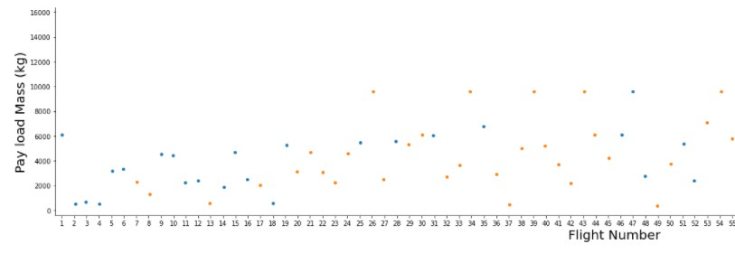
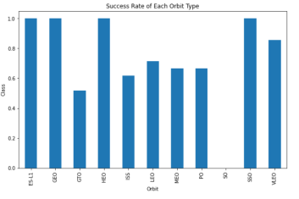
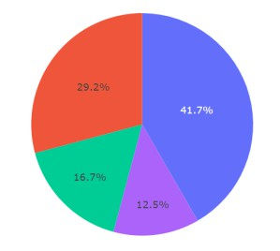
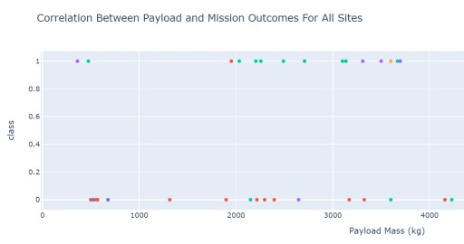
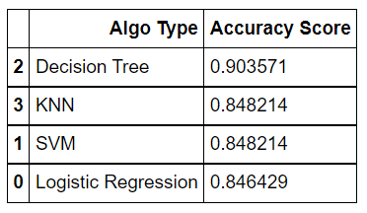
Results
Following sections and slides explain results for:
Samples:
Exploratory data
analysis results
Samples
Interactive analytics demo in screenshots
Samples
Predictive analysis
results
17

Slide 18


Slide 19
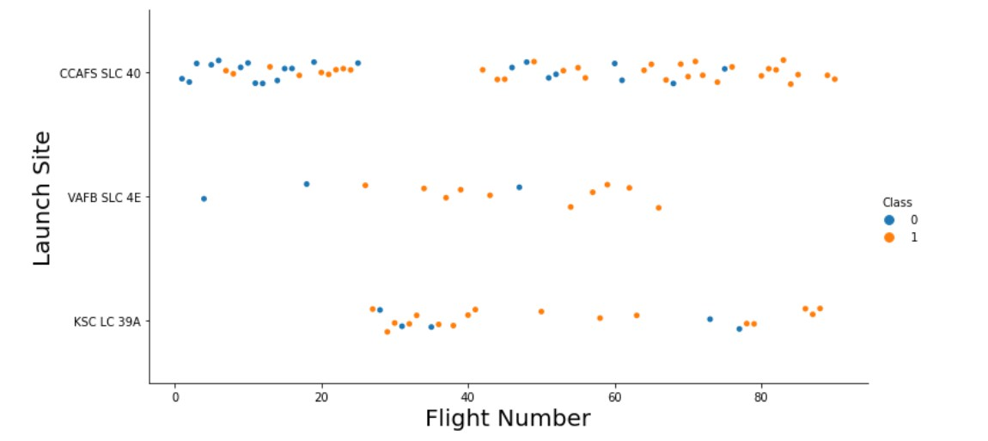
Flight Number vs. Launch Site
Success rates (Class=1) increases as the number of flights increase
For launch site ‘KSC LC 39A’, it takes at least around 25 launches before a first
successful launch

Slide 20
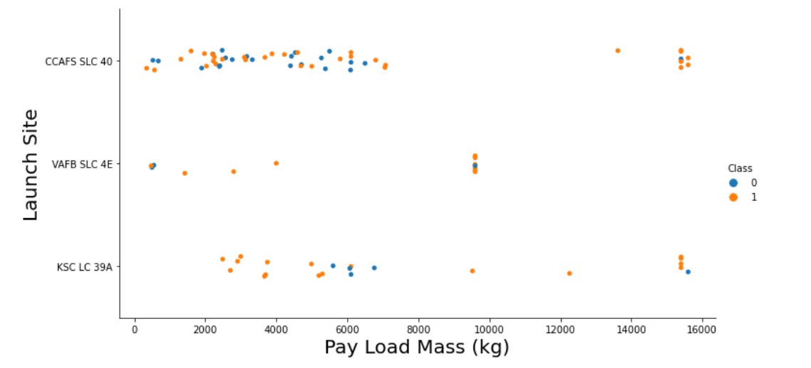
Payload vs. Launch Site
For launch site ‘VAFB SLC 4E’, there are no rockets launched for payload
greater than 10,000 kg
Percentage of successful launch (Class=1) increases for launch site ‘VAFB SLC 4E’ as the payload mass increases
There is no clear correlation or pattern between launch site and payload
mass

Slide 21
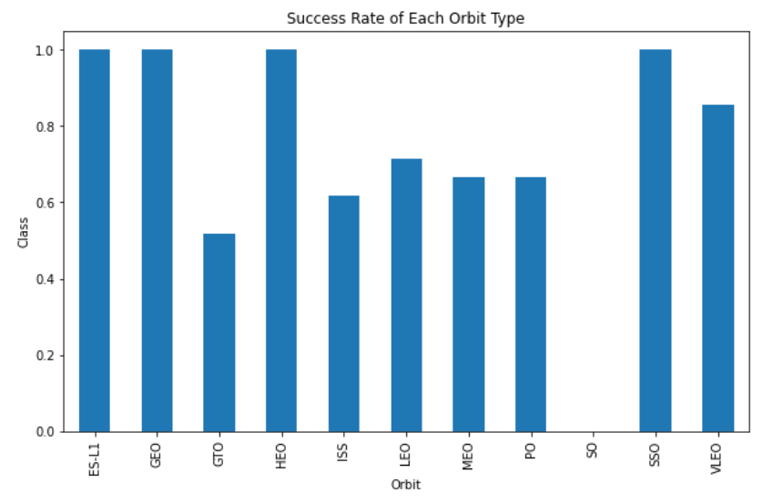
Success Rate vs. Orbit Type
Orbits ES-LI, GEO, HEO, and SSO have the highest success rates
GTO orbit has the lowest success rate

Slide 22
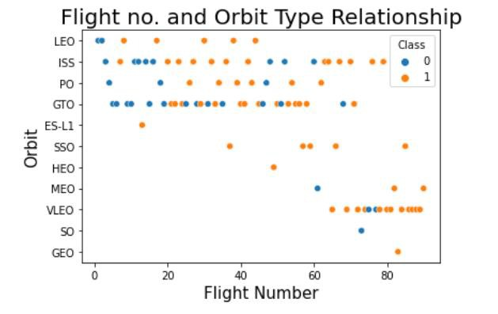
Flight Number vs. Orbit Type
For orbit VLEO, first successful landing (class=1) doesn’t occur until 60+
number of flights
For most orbits (LEO, ISS, PO, SSO, MEO, VLEO) successful landing rates appear to increase with flight numbers
There is no relationship between flight number and orbit for GTO
22

Slide 23
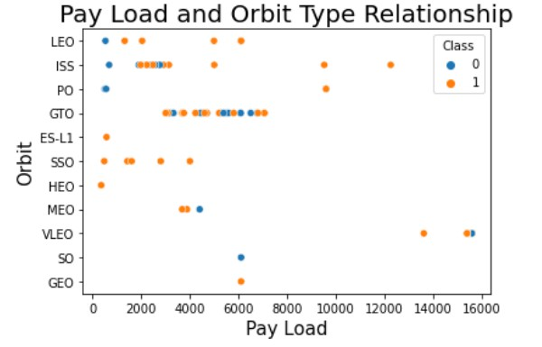
Payload vs. Orbit Type
Successful landing rates (Class=1) appear to increase with pay load for
orbits LEO, ISS, PO, and SSO
For GEO orbit, there is not clear pattern between payload and orbit for successful or unsuccessful landing
23

Slide 24
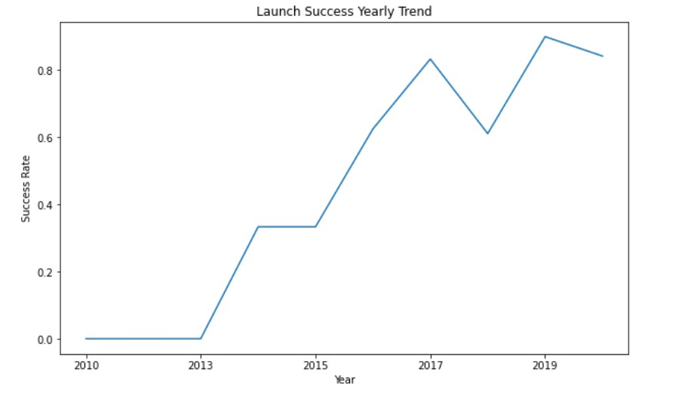
Launch Success Yearly Trend
Success rate (Class=1) increased by about 80% between 2013 and 2020
Success rates remained the same between 2010 and 2013 and between 2014
and 2015
Success rates decreased between 2017 and 2018 and between 2019 and 2020
24

Slide 25
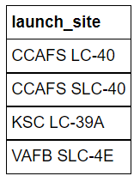
All Launch Site Names
Query:
Description:
‘distinct’ returns only unique values from the queries column (Launch_Site)
There are 4 unique launch sites
Result:

Slide 26
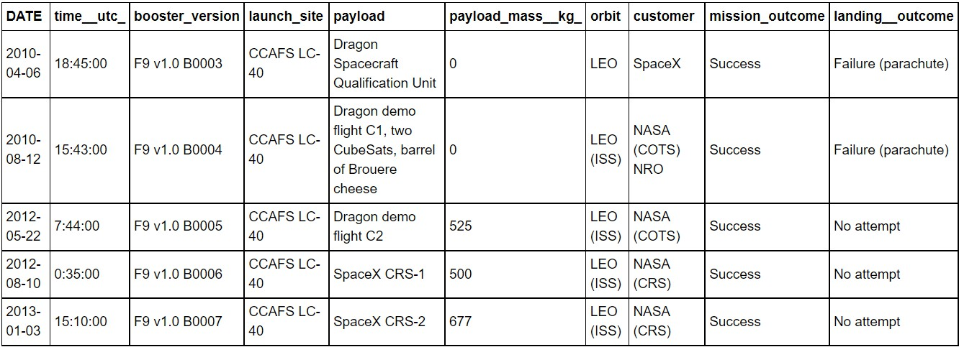
Launch Site Names Begin with 'CCA'
Query:
Description:
Using keyword ‘Like’ and format ‘CCA%’, returns records where ‘Launch_Site’ column
starts with “CCA”.
Limit 5, limits the number of returned records to 5
Result:

Slide 27
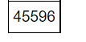
Total Payload Mass
Query:
Description:
‘sum’ adds column ‘PAYLOAD_MASS_KG’ and returns total payload mass for customers named ‘NASA (CRS)’
Result:

Slide 28
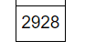
Average Payload Mass by F9 v1.1
Query:
Description:
‘avg’ keyword returns the average of payload mass in ‘PAYLOAD_MASS_KG’ column where booster version is ‘F9 v1.1’
Result:

Slide 29
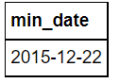
First Successful Ground Landing Date
Query:
Description:
‘min(Date)’ selects the first or the oldest date from the ‘Date’ column where first successful
landing on group pad was achieved
Where clause defines the criteria to return date for scenarios where ‘Landing_Outcome’ value is equal to ‘Success (ground pad)’
Result:

Slide 30
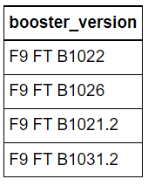
Successful Drone Ship Landing with Payload between 4000 and 6000
Query:
Description:
The query finds the booster version where payload mass is greater than 4000 but less than 6000 and the landing outcome is success in drone ship
The ‘and’ operator in the where clause returns booster versions where both conditions in the where clause are true
Result:

Slide 31
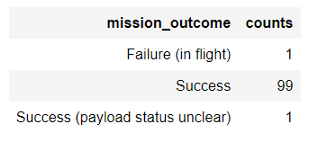
Total Number of Successful and Failure Mission Outcomes
Query:
Description:
The ‘group by’ keyword arranges identical data in a column in to group
In this case, number of mission outcomes by types of outcomes are grouped in column
‘counts’
Result:

Slide 32
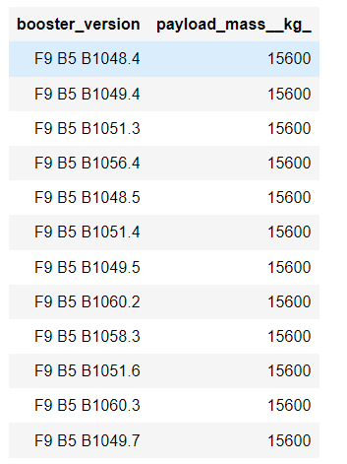
Boosters Carried Maximum Payload
Query:
Description:
The sub query returns the maximum payload mass by using keywork ‘max’ on the pay load
mass column
The main query returns booster versions and respective payload mass where payload mass is maximum with value of 15600
Result:

Slide 33
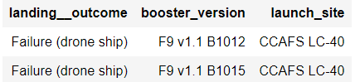
2015 Launch Records
Query:
Description:
The query lists landing outcome, booster version, and the launch site where landing outcome is failed in drone ship and the year is 2015
The ‘and’ operator in the where clause returns booster versions where both conditions in the where clause are true
The ‘year’ keywork extracts the year from column ‘Date
The results identify launch site as ‘CCAFS LC-40’ and booster version as F9 v1.1 B1012 and
B1015 that had failed landing outcomes in drop ship in the year 2015
Result:

Slide 34
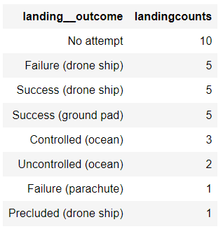
Rank Landing Outcomes Between 2010-06-04 and 2017-03-20
Query:
Description:
The ‘group by’ key word arranges data in column ‘Landing Outcome’ into groups
The ‘between’ and ‘and’ keywords return data that is between 2010-06-04 and 2017-03-20
The ‘order by’ keyword arranges the counts column in descending order
The result of the query is a ranked list of landing outcome counts per the specified date range
Result:

Slide 35


Slide 36
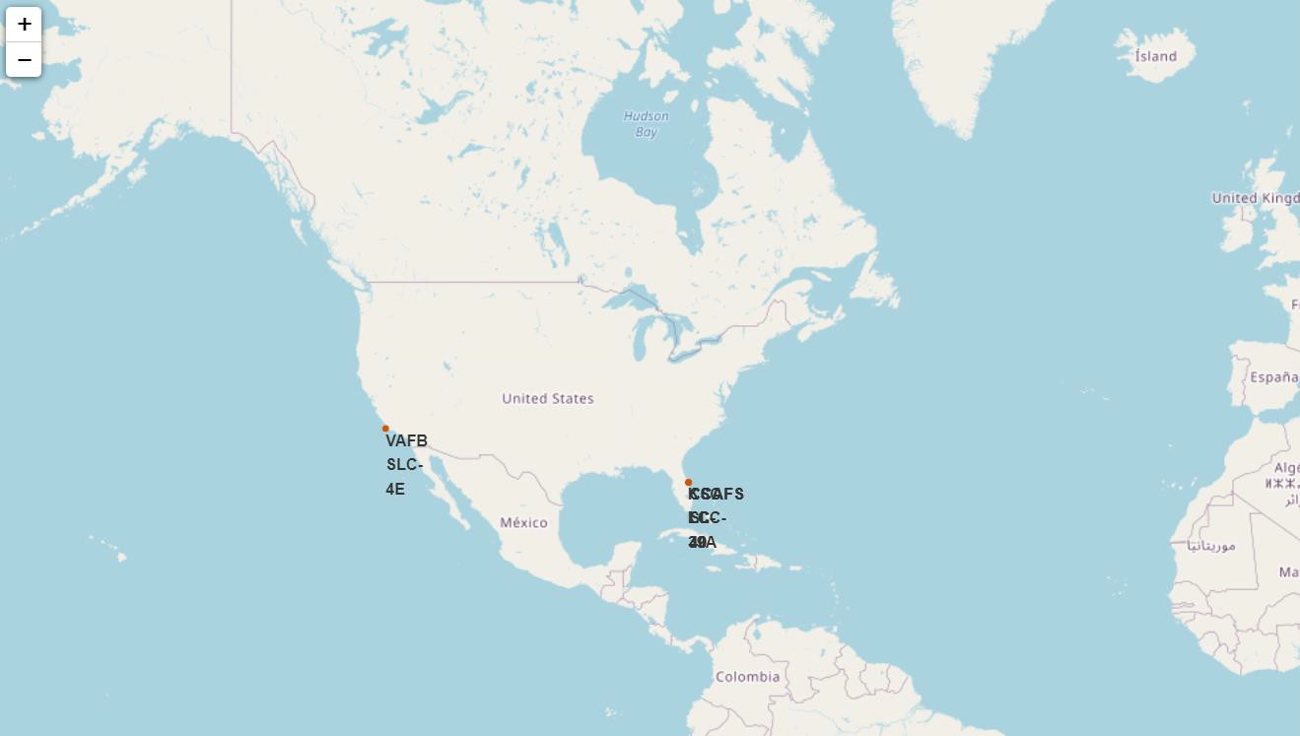
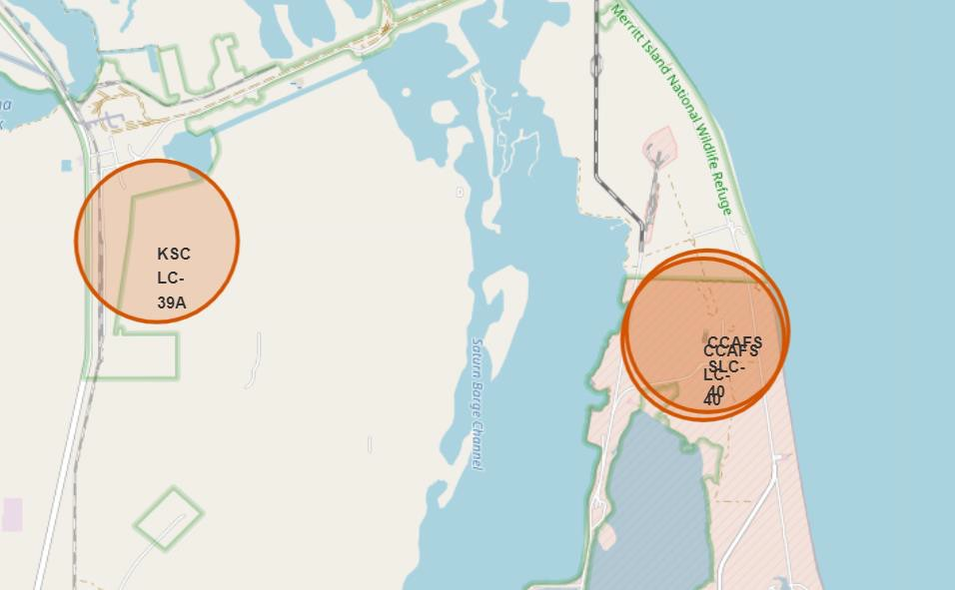
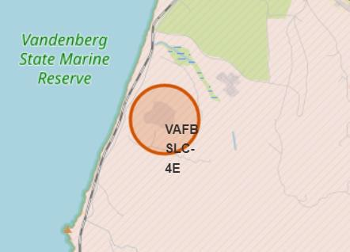
SpaceX Falcon9 - Launch Sites Map
Figure 1 (left) shows a global map highlighting Falcon 9 launch sites located in the United States, specifically in California and Florida. Each launch site is marked with a circle, labelled, and includes a popup displaying the site’s name. It is clear that all launch sites are situated near the coastline.
Figures 2 and 3 provide zoomed-in views of four specific launch sites:
VAFB SLC-4E (California)
CCAFS LC-40 (Florida)
KSC LC-39A (Florida)
CCAFS SLC-40 (Florida)
Fig 1 – Global Map
36
Fig 2 – Zoom 1
Fig 3 – Zoom 2

Slide 37
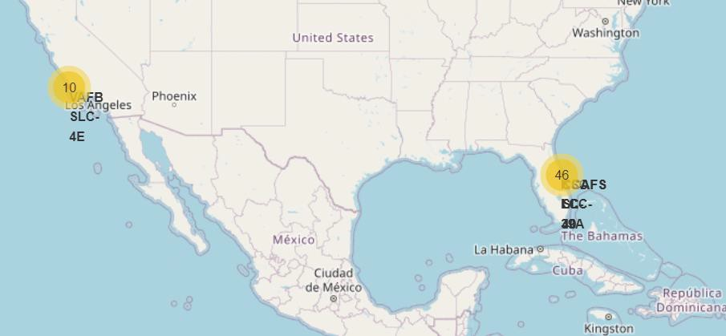
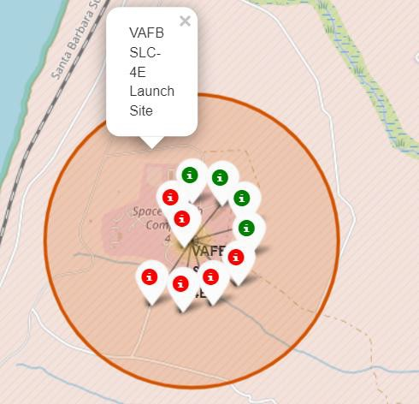
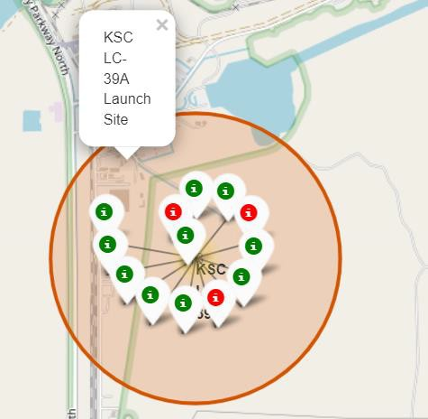
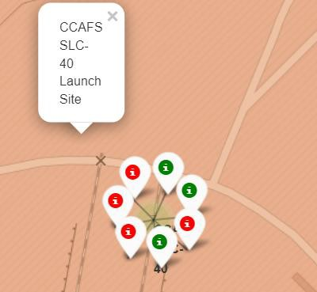

SpaceX Falon9 – Success/Failed Launch Map for all Launch Sites
Figure 1 displays a map of the United States showing all Falcon 9 launch sites. The numbers at each site represent the total count of successful and failed launches.
Figures 2, 3, 4, and 5 zoom in on individual launch sites, highlighting mission outcomes with markers—green for success and red for failure.
From these maps, it is clear that the KSC LC-39A launch site has the highest number of successful launches.
Fig 1 – US map with all Launch Sites
37
Fig 2 – VAFB Launch Site with success/failed markers
Fig 3 – KSC LC-39A
success/failed markers
Fig 4 – CCAFS SLC-40
success/failed markers
Fig 5 – CCAFS SLC-40
success/failed markers

Slide 38


SpaceX Falcon9 – Launch Site to proximity Distance Map
Figure 1 shows all proximity points marked on the map for the VAFB SLC-4E launch site. The city of Lompoc is farther from the launch site compared to other features like the coastline, railroad, and highway. The map also highlights a marker indicating the city’s distance from the launch site (14.09 km).
Figure 2 zooms in on other proximities—coastline, railroad, and highway—showing their respective distances from the launch site.
Overall, cities are located farther from launch sites to reduce risks to people and infrastructure, while launch sites are strategically placed close to coastlines, railroads, and highways for easy access to resources.
Fig 1 – Proximity site map for VAFB SLC-4E
38
Fig 2 – Zoom in for sites – coastline, railroad, and highway

Slide 39


Slide 40

Launch Success Counts For All Sites
Launch Site ‘KSC LC-39A’ has the highest launch success rate
Launch Site ‘CCAFS SLC- 40’ has the lowest launch success rate

Slide 41

Launch Site with Highest Launch Success Ratio
KSC LC-39A Launch Site has the highest launch success rate and count
Launch success rate is
76.9%
Launch success failure
rate is 23.1%

Slide 42


Payload vs. Launch Outcome Scatter Plot for All Sites
Most successful launches are in the payload range from 2000 to about 5500
Booster version category ‘FT’ has the most successful launches
Only booster with a success launch when payload is greater than 6k is ‘B4’
42

Slide 43


Slide 44

Classification Accuracy
Based on the accuracy scores—and supported by the bar chart—the Decision Tree algorithm achieved the highest classification score of 0.8750.
The accuracy score on the test data was the same for all classification algorithms, at 0.8333.
Since the accuracy scores are very close and test scores are identical, a larger dataset may be needed to better tune and differentiate the models.

Slide 45

Confusion Matrix
The confusion matrix is identical across all models (Logistic Regression, SVM, Decision Tree, and KNN).
From the matrix:
The classifier made a total of 18 predictions.
12 cases were predicted as “Yes” for landing and were indeed successful (True Positives).
3 cases were predicted as “No” and were unsuccessful (True Negatives).
3 cases were predicted as “Yes” but failed to land successfully (False Positives).
Overall, the classifier achieves about 83% accuracy (TP+TN)/Total(TP + TN) / Total(TP+TN)/Total, with a misclassification (error) rate of approximately 16.5% (FP+FN)/Total(FP + FN) / Total(FP+FN)/Total.

Slide 46
Conclusions
As the number of flights increases, the first stage is more likely to land successfully.
Success rates tend to rise with increasing payload, but no strong correlation between payload mass and success rate is evident.
Overall launch success improved by about 80% from 2013 to 2020.
KSC LC-39A has the highest launch success rate; CCAFS SLC-40 has the lowest.
Orbits ES-L1, GEO, HEO, and SSO show the highest success rates, while GTO has the lowest.
Launch sites are strategically located away from cities and near coastlines, railroads, and highways.
The Decision Tree model performed best with an accuracy of about 87.5%, while all models scored around 83% on test data.
Additional data may be required to further improve model tuning and accuracy.
46

Slide 47
Appendix
Include any relevant assets like Python code snippets, SQL queries, charts, Notebook outputs, or data sets that you may have created during this project
47

Slide 48


